Slide 1


Is there a correlation between density and the death rate in the world?
Amit Assulin

Slide 2

Table of contact
Introduction
Research questions
The research assumption
Review of the Literature
Research method
Method
Results and conclusions
Bibliography

Slide 3

Introduction
As of March 2021, the Earth's population is estimated at 8.754 billion. Every year, about 83 million people are added to the world's population, which is about 1.1 percent of its population, thus increasing the global population density. This was estimated in 2012 at approximately 52 people per square kilometer on average when dividing the total world population by the total land area (including deserts, tundra steppes, etc.). Population density is a term in the field of demography, Usually in the number of inhabitants per square kilometer (square kilometer), number of people per dunam (1000 square meters), or square meters per inhabitant.
Moreover, population density, the density of vehicles on the roads, and the number of pollutants continue to increase as a derivative of the population growth trend. Many factors as the spread of diseases and epidemics, an increase in the number of traffic accidents, and an increase in the number of greenhouse gases and CO2 in particular may be affected as the density increases and thus will affect the mortality rate. Therefore, can be said that these factors are positive feedback to the rate of mortality growth. Therefore, this study of the concept of density takes on a different face and seeks to check whether there is an indirect relationship between density and the global mortality rate.

Slide 4

Research questions
Since I chose to refer to some factors as influential, I will refer to the two main components of the study, density, and mortality, as having an indirect relationship. Accordingly, I will examine the direct relationship between each factor:
The rate of road accidents
The number of patients with the coronavirus
The number of polluting emissions of CO2
The death rate
In light of this, I chose to present the overarching question of the research and, as part of it, sub-questions relevant to the various factors.
The super question of the research: Is there a connection between density and the death rate in the world?
Sub-questions related to the main question:
Does the density of vehicles in the country affect the rate of road accidents and, consequently, the death rate?
Does the population density in the country affect mortality from diseases (corona as a representative case)?
Does the population density in the country affect the number of deaths from pollutant emissions (carbon dioxide as a representative case)?

Slide 5
The research assumption
I hypothesize that density indirectly affects mortality in some cases and to a reasonable extent. Also, I believe that each of the factors has a direct effect on the mortality rate. It is important to note that I do not take into account other factors that also affect the mortality rate; these may harm the study results and produce insufficient reliable results. Therefore, must take decisive effects of crowding regarding each factor and the mortality rate must be taken with a limited guarantee.
Overcrowding allows the passage of viral diseases, such as the coronavirus. The more crowded the country, the higher the chance that the virus will pass between people and thus affects the mortality rate. Also, with demographic growth, there is a constant increase in the level of energy consumption and the number of vehicles in the world, resulting in pollutant emissions, especially CO2. This is consistent with the fact that the mortality rate increases in this light. In addition, I believe that the density of vehicles, which is reflected in the increasing number of vehicles, affects the rate of road accidents, which also "contributes" to the death rate. Therefore, I can assess the relationship between the abovementioned factors on density affecting the mortality rate.

Slide 6

Review of the Literature
Diseases, flus, and global epidemics, such as the corona epidemic, are a major factor and are even considered to be the most influential factor in the thinning of the population and death rates in the world. According to the World Health Organization (WHO), the death rate in the last year increased mainly in light of the corona epidemic which claimed the lives of 3.41 million people, in addition to the 'fixed' death rate. A direct relationship was found that proves that population density and diseases, such as the coronavirus, are A direct connection based on the fact that the denser the country is, the faster and more intensively the disease spreads and causes an increase in the death rate (A.Bhadra et al, 2020). Moreover, in another article, they found that population density is a dominant factor in accelerating contagion (Anderson and May, 1981).
Another factor that has a significant impact on the mortality rate in the world is traffic accidents. According to reports from the World Health Organization (WHO) annual summaries, road accidents are the second cause, right after diseases, from which most people are killed worldwide. Although the last year, a decrease in the percentage of road accidents is noticeable, due to the corona epidemic and the fact that the closures left us in homes and thus, the number of vehicles on the roads has decreased significantly, it is expected to increase (R. Gedborg, 2010).

Slide 7

Review of the Literature
Human activity since the pre-industrial era has resulted in a significant increase in air pollution (IPCC, 2001). Measurements at various sites in the Northern Hemisphere indicate an increase from 1860 to 2000 in surface ozone (O3) almost four times. Also, increased sulfur concentration in Greenland's ice cores and many carbon dioxide (CO2) emissions doubled significantly. A study conducted in the USA investigated the changes in the number of pollutants in the last hundred years using a global climate model. The results indicated a significant increase in the number of contaminants due to human activity, which causes an increase in the death rate every year (Y.Fang et al. 2013). The rise in air pollution and greenhouse gas emissions, the increase in the human population in the Middle East, and the density in every country are increasing.
In another article, they proved a direct connection between the increase in population and density in the world and the increase in the number of emissions which are a significant cause of mortality in the world (C.Fan. 2018).

Slide 8
Research method
Finally, I will conduct a correlation test between the different types of density and the mortality rate. I will try to understand as a general trend whether there is a connection between the two. This type of analysis, expressed through various graphs, will allow me to understand whether there is a specific trend that indicates a relationship between the multiple factors that strengthen our claim that there is indeed a connection between density and the death rate in the various countries. I will strive to get clear trends regarding each research question and understand the relationship between the factors. The results of the research will be presented using various maps and graphs.
First, I will collect data based on the population density and the death rate in all countries. At the same time, I will collect data on significant causes of mortality among populations in the world, such as the number of road accidents each year, the amount of greenhouse gas emissions (focusing on CO2), and diseases (concentrating on the coronavirus).
Second, I will edit and organize the databases according to my needs. I will gather all this data into one database by consolidating tables that include the information relevant to the study.
The database will include the following columns:
Country names
Population size
Population density
Number of vehicles per 1,000 people
The death rate from traffic accidents
The death rate from air pollution
The death rate from corona
The general death rate

Slide 9
Is there a connection between density and the death rate in the world?
At this stage, I would like to understand whether, in general, there is a relationship between population density (X) and the death rate in the world (Y). Therefore, I chose a representative year, 2014, and I created a table with the columns: country, death rate, population rate, and population density. From there, I made these graphs, where at the top, I removed the extreme value (Singapore, the most densely populated country in the world) not to harm the study results. I performed a correlation test and a Pearson correlation, and it is clear that the relationship between the variables is negative, and there is almost no relationship.

Slide 10
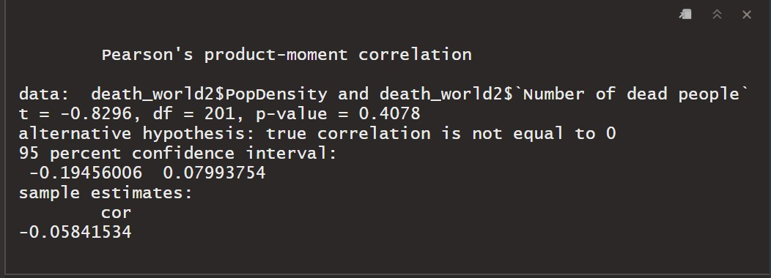
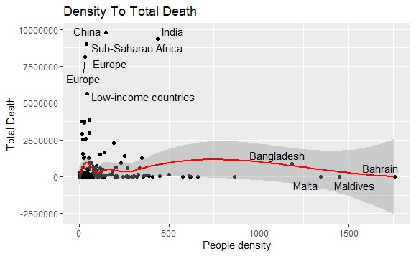
Is there a connection between density and the death rate in the world?

Slide 11
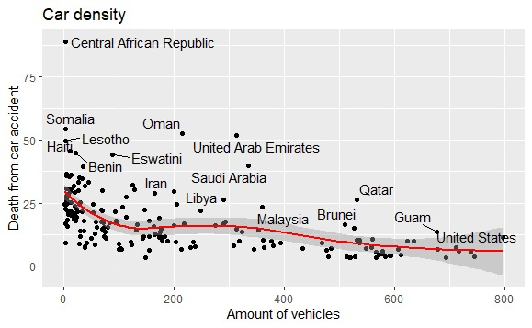
Does the density of vehicles affect the rate of road accidents and, consequently, the death rate?
From the vehicle database, I selected the same representative year, 2014. I created a table that includes the columns:
Country
Number of vehicles per 1,000 people
The death rate from traffic accidents
From this, I would like to understand whether the more cars there are on the road, the more deaths from road accidents. The graph shows the opposite trend - in countries with more vehicles, there are fewer deaths from road accidents.

Slide 12
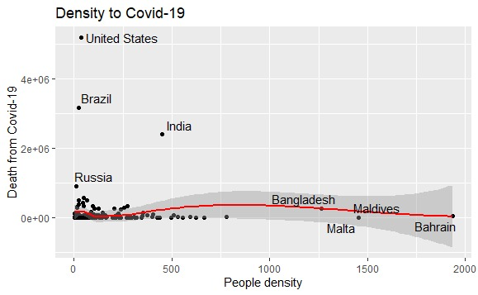
Does the population density in the country have an effect on mortality from the coronavirus?
From the database of the coronavirus, I chose a representative day (12/08/2020).
I created a neat table with the columns: country, number of deaths from corona, population size, and population density.
From this, we would like to understand whether the more crowded a country is, the more deaths from Corona. In this case, too, I removed the extreme values ​​to get a clearer picture of the nations.

Slide 13
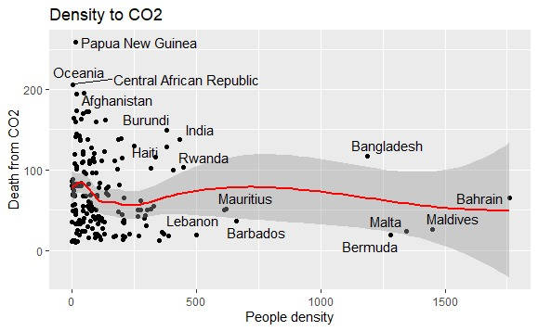
Does population density affect the number of deaths from carbon dioxide emissions?
From the database of air pollutants, I selected a representative year, 2014, which I added to the population table based on the countries to check whether, as the density increased, the number of deaths resulting from carbon dioxide emissions also increased. I also lowered this extreme value to get a more reliable data trend.

Slide 14
‏Results and conclusions
Surprisingly, no positive relationship was found between the variables: density and the death rate. Moreover, the association found is negative and almost non-existent. Therefore and accordingly, even among the various factors that indicate density, the same results were not obtained. Regarding mortality as a result of the corona, no uniform trend was presented, emphasizing that the more crowded a country is, the higher the mortality. This result surprised me, but I assume that some of the information in the database is flawed since the number of tests and the government's policy (closures and wearing masks, for example) was different between countries and on the test date (August 12, 2020).
Even in the issue of the death rate as a result of road accidents, no significant trend was shown, emphasizing that the more vehicles there are, the death rate is increasing. Regarding this, it is possible that in various countries, other factors reduce the number of accidents, such as education, policy, travel habits, infrastructure, etc. In addition, regarding the mortality rate due to exposure to carbon dioxide, it was not decided that the mortality rate due to CO2 in countries with greater density is also the highest

Slide 15
‏Results and conclusions
. I can base this idea on the fact that different countries act in various ways to prevent air pollution, such as promoting laws and increasing enforcement, environmental impact reviews, raising public awareness, providing economic incentives, reducing the culture of consumption, using technological means, etc.
Moreover, extreme values, as we know, may significantly disrupt the study's results. In my case, even after removing the extreme values, the trend I assumed was not obtained.
In conclusion, my hypothesis in this study is inconsistent with the results obtained. One should not think that density does not affect any of the factors presented in the study, but it appears that it does not have the upper hand regarding mortality.

Slide 16
Bibliography
- Anderson RM and May RM. 1981. The population dynamics of microparasites and their invertebrate hosts. Philosophical Transactions of the Royal Society of London. B, Biological Sciences 291(1054): 451-524
- Bhadra, A., Mukherjee, A., & Sarkar, K. (2021). Impact of population density on Covid-19 infected and mortality rate in India. Modeling Earth Systems and Environment, 7(1), 623-629.‏
- Boeing, G. (2018). Estimating local daytime population density from census and payroll data. Regional Studies, Regional Science, 5(1),
- Demographic change and carbon dioxide emissions. The Lancet, 380(9837), 157-164.‏
https://www.gapminder.org/data/ Retrieved: 14.1.21
- Fan, C., Tian, L., Zhou, L., Hou, D., Song, Y., Qiao, X., & Li, J. (2018). Examining the impacts of urban form on air pollutant emissions: Evidence from China. Journal of environmental management, 212, 405-414.‏.
- Fang, Y., Naik, V., Horowitz, L. W., & Mauzerall, D. L. (2013). Air pollution and associated human mortality: the role of air pollutant emissions, climate change and methane concentration increases from the preindustrial period to present. Atmospheric Chemistry and Physics, 13(3), 1377-1394.‏O'Neill, B. C., Liddle, B., Jiang, L., Smith, K. R., Pachauri, S., Dalton, M., & Fuchs, R. (2012).
Gedeborg, R., Thiblin, I., Byberg, L., Melhus, H., Lindbäck, J., & Michaelsson, K. (2010). Population density and mortality among individuals in motor vehicle crashes. Injury Prevention, 16(5), 302-308.
- United Nations, Department of Economic and Social Affairs, Population Division (2019). World Population Prospects: The 2019 Revision (https://population.un.org/wpp/)
- World Health Statistic 2021 - https://cdn.who.int/media/docs/default-source/gho-documents/world-health-statistic-reports/2021/whs-2021_20may.pdf?sfvrsn=55c7c6f2_13

Slide 17
Thank you

